Slide 1


Slide 2
Recursive Function
Calls In MIPS Assembly
Beyond the LMC

Slide 3
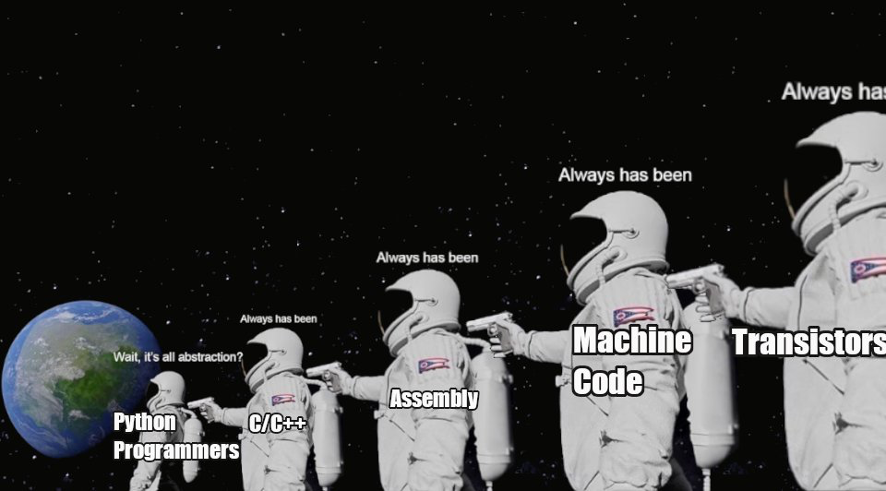
Course Syllabus

Slide 4
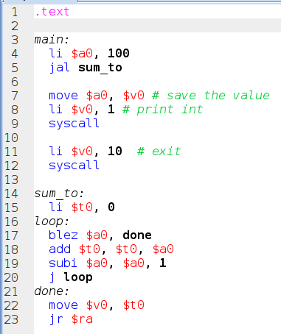
Functions
In the last class we looked at an iterative implementation of the following C-style function: int sum_to(int x) { int temp = 0; while(x > 0) { temp += x--; } return temp }
Notes:
Can be found online… but I can’t link to it

Slide 5
Functions
We used the following calling convention:
$a0....$a3 - arguments
$v0, $v1 - return values
$ra - return address
Remember, functions aren’t real: they are just instructions sitting in memory somewhere
The calling conventions are what make them work
Notes:
Can be found online… but I can’t link to it

Slide 6
Functions
What if we wanted to implement our algorithm recursively rather than iteratively: int sum_to(int x) { if(x < 0) { return 0; } else { int temp = sum_to(x - 1); return x + temp; } }
Notes:
Can be found online… but I can’t link to it

Slide 7
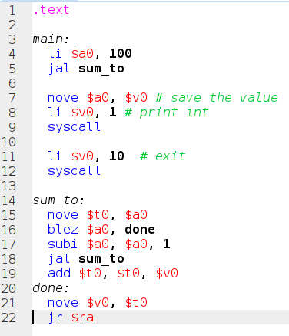
Functions
A first attempt:
First move $a0 into a temp register
If the value is 0, move it into the return value register and return
If not, subtract one from $a0 and call sum_to again
Add the result of that to the temp register and fall through to return
Notes:
Can be found online… but I can’t link to it

Slide 8
Functions
This looks somewhat plausible
However, when we run it, we get into an infinite loop
Why?
Notes:
Can be found online… but I can’t link to it

Slide 9
Functions
When we call sum_to recursively, we stomp on the initial value of $ra from the main: code sequence
That return address is gone forever when we call the jump and link in the body of the sum_to function
Notes:
Can be found online… but I can’t link to it

Slide 10
Functions
Additionally, every time we call sum_to, it is going to overwrite the $t0 register
If we called any other functions, those could also overwrite the $t0 register!
OK, so what do we need to do?
Notes:
Can be found online… but I can’t link to it

Slide 11
Functions
We need a place to store all these values when function calls are made
In order to support recursive function calls (and, in fact, even non-recursive function calls) we need to define another convention
That convention is called The Stack
Notes:
Can be found online… but I can’t link to it

Slide 12
Functions
The Stack is just a place in memory that is allowed to grow and shrink according to your needs for a given function call
“It” consists of a pointer to a memory address
You move this stack pointer down in memory to allocate space on the stack
Notes:
Can be found online… but I can’t link to it

Slide 13
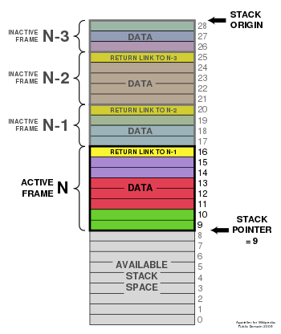
Functions
This is because, conventionally, the stack starts at the top of memory and grows down
A function call allocates a stack frame by bumping the stack pointer by some amount
Notes:
Can be found online… but I can’t link to it

Slide 14
Functions
This “stack frame”, which is just some memory you claim for a specific function invocation, can then be used to store data, such as:
The return address
Any local variables
Any temporary computed values
Notes:
Can be found online… but I can’t link to it

Slide 15
Functions
Again, the stack is crucial for allowing recursive functions:
Recursive functions require that the same named variable (e.g. temp in our code) be able to hold multiple values at the same time
Notes:
Can be found online… but I can’t link to it

Slide 16
Functions
Visually: sum_to(3) -> temp = 3 sum_to(2) -> temp = 1 sum_to(1) -> temp = 0
Some early languages (e.g. Fortran) explicitly forbid recursion because variables were only allowed to have one value at a time
This constraint actually made Fortran fast
Notes:
Can be found online… but I can’t link to it

Slide 17
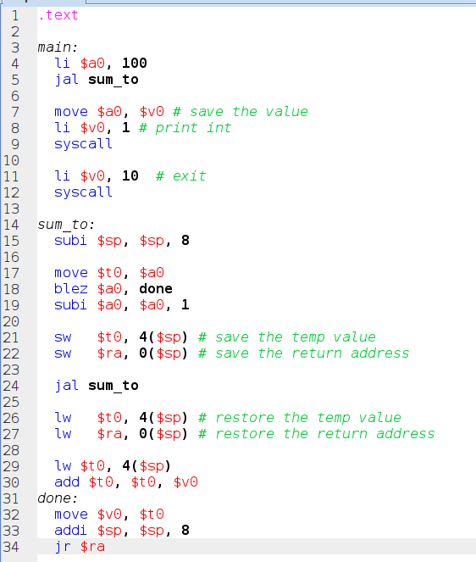
Functions
Once again, we are going to need some hardware support for the conceptual entity of a stack
MIPS gives us the $sp or “stack pointer” register, which points to the current address at the “top” of the stack
Remember the stack is “upside down”
Notes:
Can be found online… but I can’t link to it

Slide 18
Functions
The first thing we need to do is bump the stack pointer down
The stack grows from the top of memory down on most platforms
What registers do we need to save so that they can be restored after a function call is made?
Notes:
Can be found online… but I can’t link to it

Slide 19
Functions
Two values get overwritten in the recursive sum_to function:
$t0 - the temporary register we are using to store the ongoing summed value
$ra - the return address to jump do when the function completes
Notes:
Can be found online… but I can’t link to it

Slide 20
Functions
Now, MIPS is a 32 bit platform and both registers are 32 bit (1 word or 4 bytes) wide
In MIPS, as on most platforms, memory is byte-addressed
Address “0” points to the first byte of memory
Address “1” points to the second byte in memory
Notes:
Can be found online… but I can’t link to it

Slide 21
Functions
So, we need to move the stack pointer by a total of 8 bytes
4 bytes for the 32-bit temporary value in $t0
4 bytes for the 32-bit return address in $ra
Hence, we subtract 8 from the current stack pointer
Notes:
Can be found online… but I can’t link to it

Slide 22
Functions
OK, next change
Before we make the recursive call to sum_to, we need to store the values of $t0 and $ra onto the stack
We do this by calling save word (sw) instruction with offsets from the new stack pointer
Notes:
Can be found online… but I can’t link to it

Slide 23
Functions
The return address, $r0 is stored at offset 0 from the stack pointer
The temporary value, $t0, is stored 4 bytes “higher” in memory
That’s what the funny 4($sp) syntax means
You can think of it as stack[4], if stack were a byte array starting at the address $sp points to
Notes:
Can be found online… but I can’t link to it

Slide 24
Functions
With our temporary values stored safely on the stack, we can then make a recursive call to sum_to
When the function completes, leaving its return value in $v0, we can then restore the values of $t0 and $ra from the stack, using the load word (lw) instruction
Notes:
Can be found online… but I can’t link to it

Slide 25
Functions
We use the same offsets that we used to save the values, and we should get the original (pre call) values back!
Magic, everything works now!
Except… there is one register we are modifying and not saving…
Which one?
Notes:
Can be found online… but I can’t link to it

Slide 26
Functions
What about the $sp register?
We are modifying it by subtracting 8 from it on line 15, right?
Aren’t recursive calls also modifying it?
Yep, they are
But look down a bit further, just before our return jump
Notes:
Can be found online… but I can’t link to it

Slide 27
Functions
Note that we are bumping the stack pointer back up by the same amount that we bumped it down when we entered the procedure
So, if our child call bumps the $sp pointer down (it will) then it will restore it before it comes back
Notes:
Can be found online… but I can’t link to it

Slide 28
Functions
This means that the stack pointer will be the same value as it was before the current invocation of the function occurred
This is the final component of our calling convention: who is responsible for preserving a register value
Notes:
Can be found online… but I can’t link to it

Slide 29
Functions
Some registers must be preserved by the “caller”
The temporary registers
The argument registers
The return value registers
The return address
Some registers must be preserved by the “callee”
The stack pointer
$s0-s7
Notes:
Can be found online… but I can’t link to it

Slide 30
Functions
In our recursive sum_to() implementation we see both of these cases
We save $ra and $t0 before making the recursive call
Caller responsibility
We restore $sp before we return from an invocation
Callee responsibility
Notes:
Can be found online… but I can’t link to it

Slide 31
Functions
The code before the function call is made is called the function prologue
The code after the function call is made is called the function epilogue
Together the two are sometimes called the function perilog
Notes:
Can be found online… but I can’t link to it

Slide 32
Functions
As a side note, bumping the stack pointer down is how you can have a StackOverflow
You bumped the stack pointer down too many times and ran out of memory due to too many function calls!
Notes:
Can be found online… but I can’t link to it

Slide 33
Functions
So we now have a complete calling convention for our MIPS system
$a0-a3 - arguments
$ra - return address
$v0, $v1 - return values
$sp - stack pointer
+ the caller & callee saved register conventions
Notes:
Can be found online… but I can’t link to it

Slide 34
Functions
This is very similar to calling conventions on other platforms such as x86 or ARM
Once again, important to stress that function calls aren’t real
It is just an imaginary convention that we use to organize our code
Notes:
Can be found online… but I can’t link to it

Slide 35
Functions
Nonetheless, software engineering without functions would be impossible
An important philosophical point: things that aren’t “real” are sometimes as important (or maybe more so) than things that are!
Santa Claus
Notes:
Can be found online… but I can’t link to it

Slide 36
MIPS
To properly implement the function call fiction on a register-based chip such as MIPS, it is necessary to have a “Stack”
The Stack consists of a pointer to memory where temporary values can be stored during function calls
For a given function invocation, the memory it uses is called its “Stack Frame”
In order to properly utilize the stack, callers and calles must coordinate with one another to store and restore values at the proper times

